Slide 1
VOKI
Getting Started
Voki
Logon to www.voki.com
Click on Voki for Educat5ion
Click on Register
Type in your email, chose a password, your birthday, teacher, grade level, click yes for educator.
Login
You will receive an email confirmation that your account is active, please check your SPAM if you do not receive this email.
A Voki allows you to personalize an avatar to embed in applications. Students can use Avatars to help explain an argument, speak in a foreign language or portray a character in a novel.
Index
Getting Started ……………………………………………… 1
Notes:
Go over the commands and the ribbon and how you access items in Outlook

Slide 2
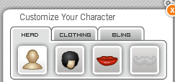
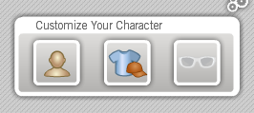
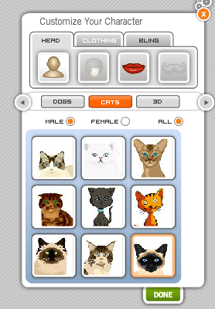
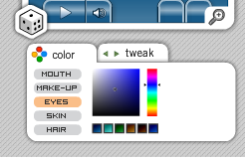
VOKI
Click on Create
Let’s Begin to create the Avatar
Click on the Person Icon
You can change the hair, lips
You can change the clothing
You can change the bling
Play around with these accessories until you have created the look for your avatar
Click on Cats, Dogs, people, etc.
Choose Female/Male All while searching
When you have your character
Click Done
NOTE: the grad hats require you to have the upgraded version
Under the Avatar you can change the color of mouth, make-up, eyes, skin and hair.

Slide 3
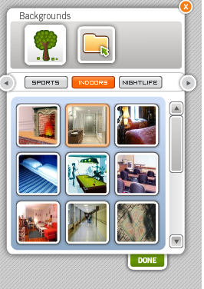
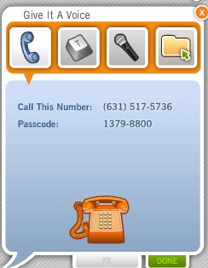
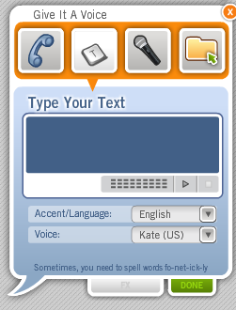
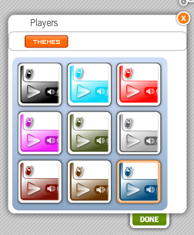
VOKI
Backgrounds
Give It A Voice
Choose one of the four recording options:
Phone
Click on the Phone
You will be given a phone number and passcode
Record your message
Click Done
Computer Key
Click on the Computer Key
Type in your message
Choose you Accent/Language (with the dropdown menu)
Choose your Voice from the dropdown menu
Click on the arrow to preview your message
Click Done When Finished
Click on backgrounds to change what is behind your Avatar.
You can click on the folder and import your own background
Click Done
Players
Click on Players to put the color and type of frame and player around your Avatar.
Click Done

Slide 4
VOKI
Click on the Microphone
Click on Record
Record your message
Click Save
Click on the arrow to listen to your message
Click Done

Slide 5
VOKI

Slide 6
VOKI

